Slide 1
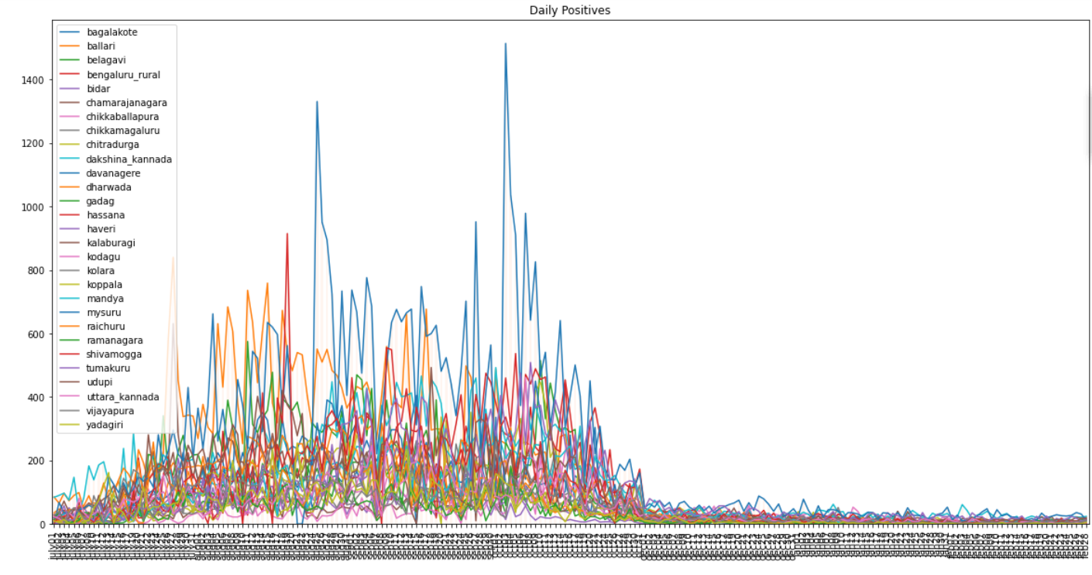
Wave: 01
The following graph plots the number of daily positive cases from July 1, 2020 to February 28, 2021.
The first COVID-19 wave seems to have concluded during October .2020.

Slide 2
